Slide 1

Cloud Computing Security Case Study Presentation
BY
Aajith
Yong hoow
Raj

Slide 2
Introduction
AWS has commercial regions globally across multiple continents (North America, Europe, Asia, Australia, Africa, and South America).
Regions cater to diverse customer needs and preferences.
Separate Availability Zones for web tier, application tier and data tier .

Slide 3
What AWS services are included?
Web Tier
Amazon Load Balancer: Distribute traffic to web servers
Auto Scaling group: Ensure scalability and availability
Application Tier
Internal Load Balancer: Routes traffic from web tier to app servers
Auto Scaling group: Dynamically adjust app server count
Data Tier
Multi Availability Zone: High availability for relational databases
Migration
Transit Gateway: Connects AWS environment to on-premises infrastructure

Slide 4

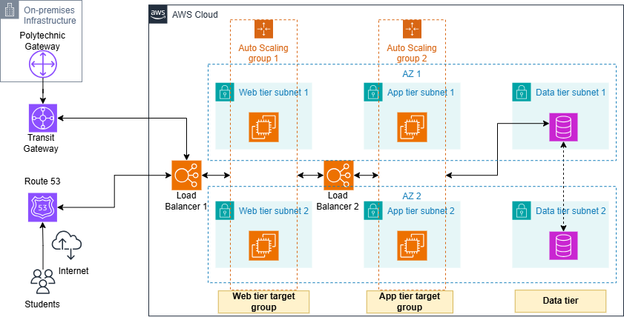

Slide 5
Task 2A: Advantage and Disadvantage
Benefits of AWS:
User-friendly: Simple to utilize with rapid and secure access, extensive documentation, and video instructions.
Flexible: Allows use of familiar web application platforms, programming languages, and operating systems.
Secure: Offers end-to-end security strategy with multiple tiers of data monitoring and protection.
Cost-effective: Pay-as-you-go pricing model, no-commitment service, and cheaper than traditional computing methods.

Slide 6
Disadvantages of AWS:
Limitations: Resource limits, particularly with EC2 and security, can be restrictive.
Lack of Experts: Shortage of professionals knowledgeable about AWS can make it difficult for companies to find suitable experts.
Price Variations: Service prices vary by region, and technical support costs can impact monthly bills.
General Issues: Temporary downtime and server issues can occur due to power loss or network connectivity problems.

Slide 7
Task 2B: Identify risks, analyze, and propose mitigating measures
Compromised Access Credentials: Unauthorized access to AWS resources due to stolen or leaked credentials. Mitigating measures include MFA, regular credential rotation, and secure storage.
Misconfigured S3 Buckets: Data breaches due to publicly accessible or overly permissive S3 buckets. Mitigating measures include automated configuration validation, secure access controls, and encryption.

Slide 8
Excessive IAM Permissions: Unauthorized access to AWS resources due to excessive IAM permissions. Mitigating measures include least privilege access, IAM role-based access control, and regular review of IAM policies.
Insecure APIs: Exploitation of insecure APIs leading to data breaches or security incidents. Mitigating measures include API Gateway, API security controls, and regular security testing.
Insufficient Logging and Monitoring: Inability to detect and respond to security incidents due to lack of logging and monitoring. Mitigating measures include enabling CloudTrail, CloudWatch, and regular log analysis.

Slide 9
Task 2C: Establish a roadmap to implement AWS cloud computing and on-premises set up in the organization.
Inventory existing infrastructure: Document current on-premises infrastructure, including servers, storage, and network equipment.
Identify workloads for migration: Determine which applications and workloads can be migrated to AWS, considering factors like security, compliance, and performance requirements.
Define security and compliance requirements: Establish security policies, compliance requirements, and data governance frameworks for both on-premises and cloud environments.
Develop a cloud strategy: Outline operation aims, cost optimization strategies, and performance metrics for the hybrid cloud setup.

Slide 10
Phase 2:AWS Setup and Migration (Weeks 5-12)
Create an AWS account: Set up an AWS account and configure the necessary IAM roles, users, and permissions.
Provision AWS resources: Create and configure AWS resources, such as EC2 instances, S3 buckets, and RDS databases, for migrated workloads.
Migrate workloads: Migrate identified workloads to AWS, using tools like AWS Migration Hub, AWS Database Migration Service, or third-party migration tools.
Configure security and monitoring: Set up security groups, monitoring tools (e.g., CloudWatch), and logging mechanisms for AWS resources

Slide 11
Phase 3: On-Premises Setup and Integration (Weeks 13-20)
Upgrade on-premises infrastructure: Upgrade or replace existing on-premises infrastructure to ensure compatibility with AWS services and meet business requirements.
Configure hybrid connectivity: Establish a secure and reliable connection between on-premises infrastructure and AWS using VPN, Direct Connect, or other connectivity options.
Integrate on-premises and AWS services: Integrate on-premises services with AWS services, such as using AWS Storage Gateway or AWS Outposts.
Implement unified monitoring and management: Set up unified monitoring and management tools to oversee both on-premises and AWS resources.

Slide 12
Phase 4: Optimization and Maintenance (After Week 20)
Monitor and optimize costs: Use AWS Cost Explorer to track costs, identify optimization opportunities, and implement cost-saving measures.
Continuously monitor performance: Monitor performance metrics, identify bottlenecks, and optimize resources as needed.
Maintain security and compliance: Regularly review and update security policies, ensure compliance with regulatory requirements, and perform security audits.

Slide 13
Thank you

